Slide 1
3D Mobile Application for Learning Human Brain.

Slide 2
Our Team
Team Members:
Mohammad Hasnain
Sajjad Ali
Mujeeb Ahmed
Supervised by:
Dr. Ahsanullah Abro

Slide 3
Agenda
Introduction of Design Document
Entity Relationship Diagram (ERD)
Sequence Diagrams
Architecture Design Diagram
Database Diagram
Class Diagram
Interface Design
Test Cases
Appendices

Slide 4
Introduction of Design Document
Software Design Specification (SDS) for the Final Year Project (FYP) entitled "3D Android Tutorial App using Unity." The app aims to provide a comprehensive and interactive learning experience for students studying the four perspectives of Taxonomy, Anatomy, Morphology, and Physiology.

Slide 5
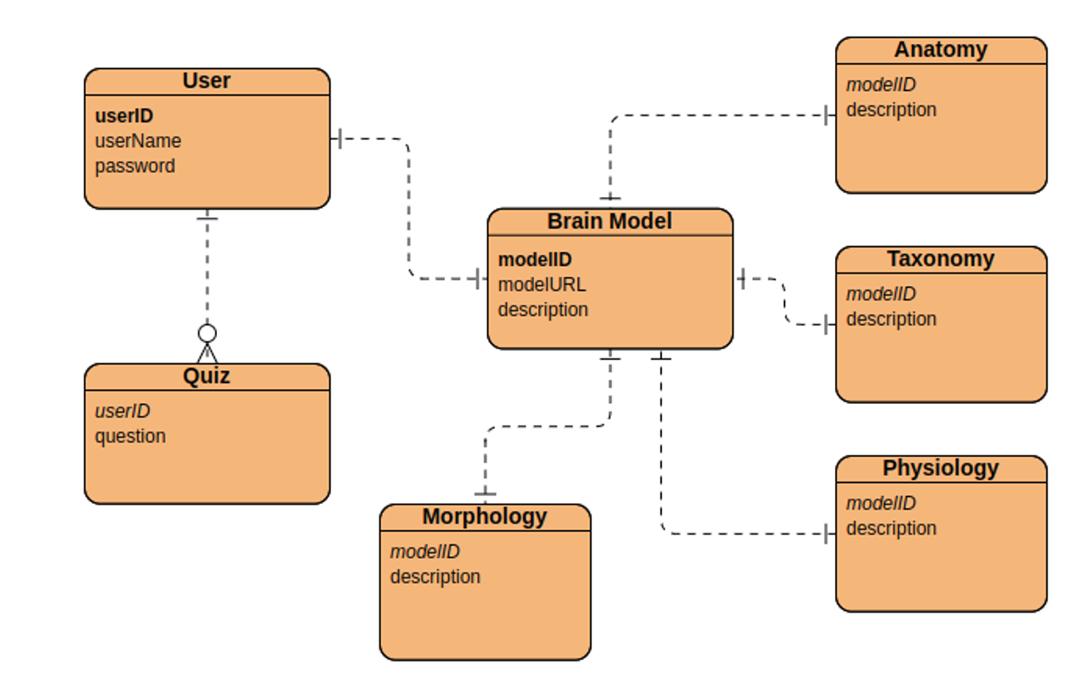
Entity Relationship Diagram (ERD)

Slide 6
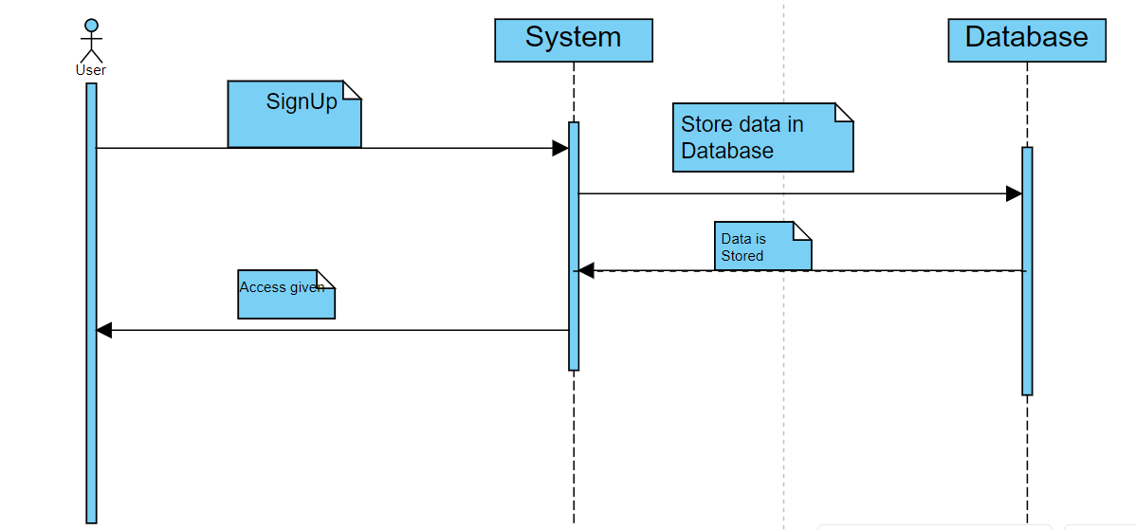
Sequence Diagrams
Sign up:

Slide 7
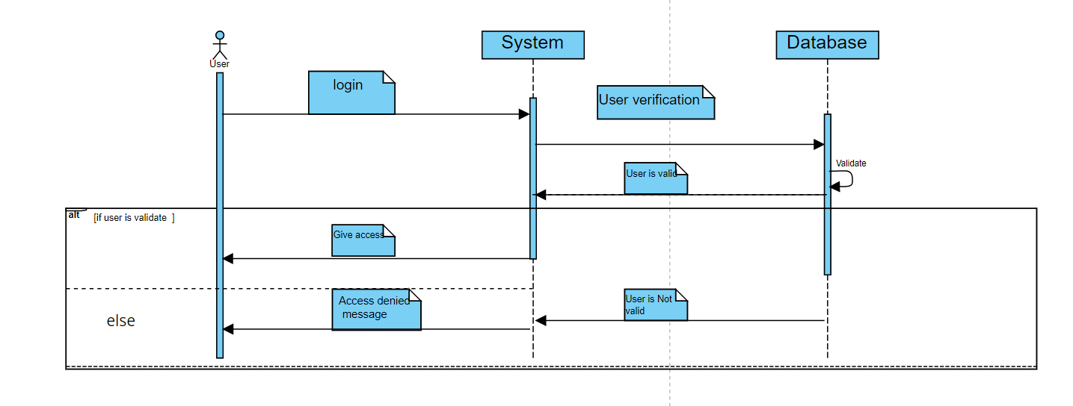
Sequence Diagrams
Login

Slide 8
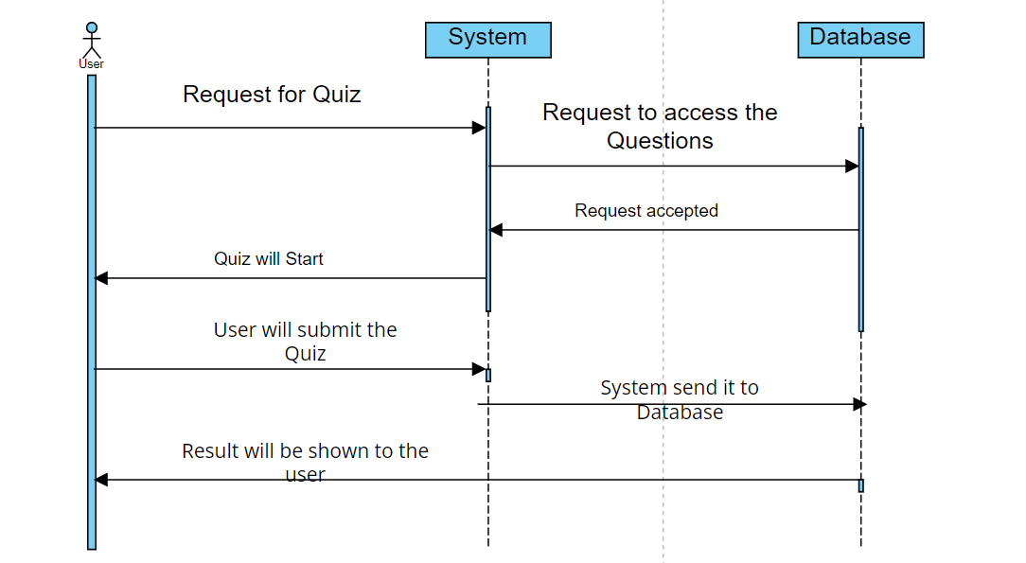
Sequence Diagrams
Take Quiz/Assessment

Slide 9
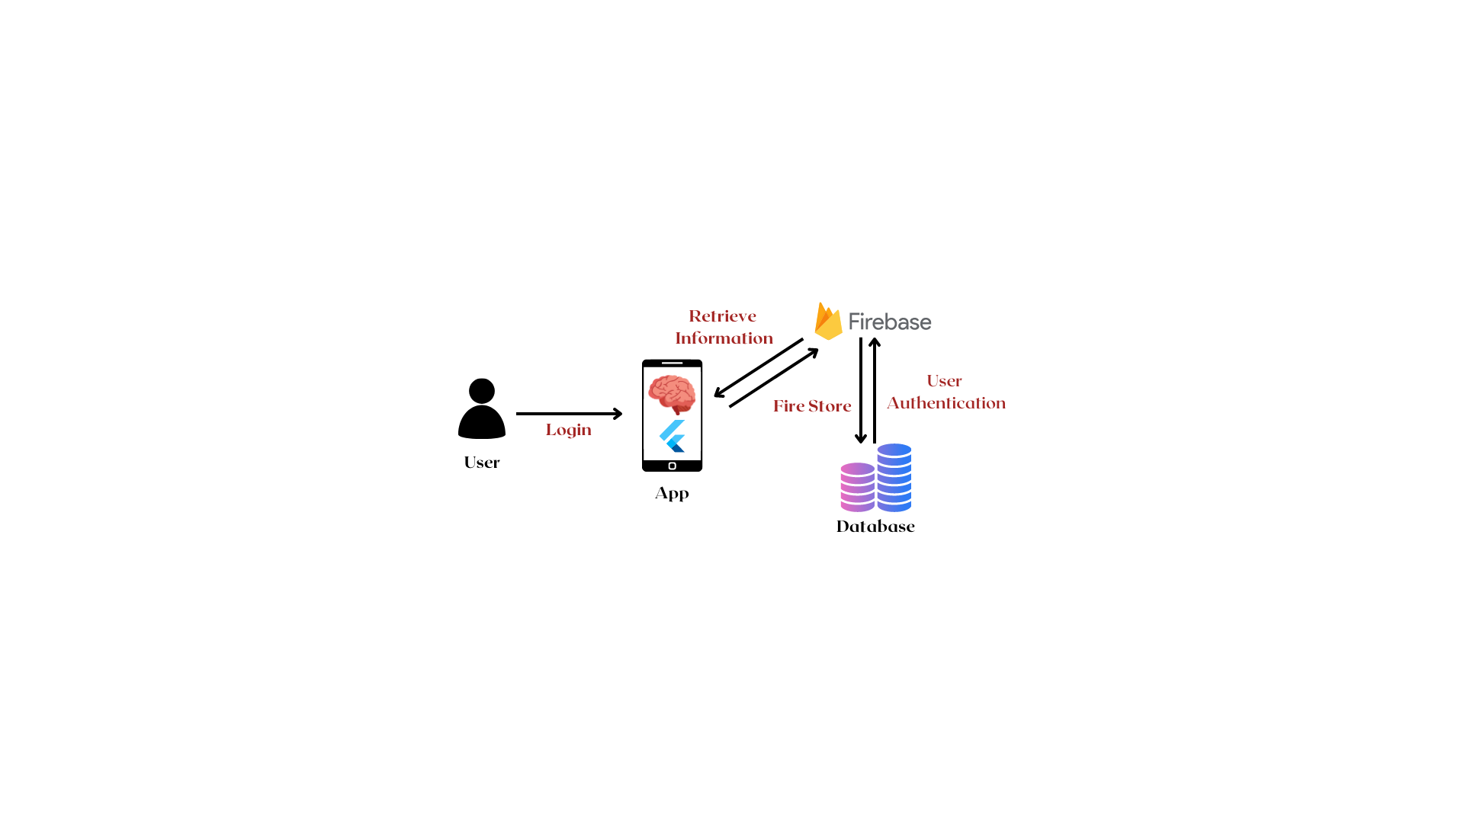
Architecture Design Diagram

Slide 10
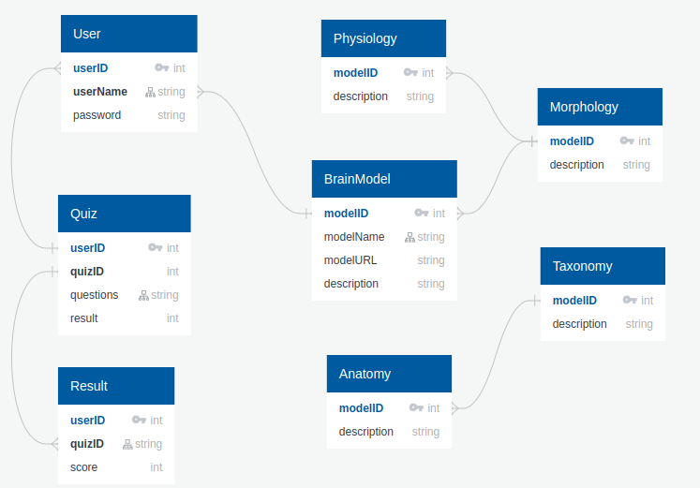
Database Diagram

Slide 11
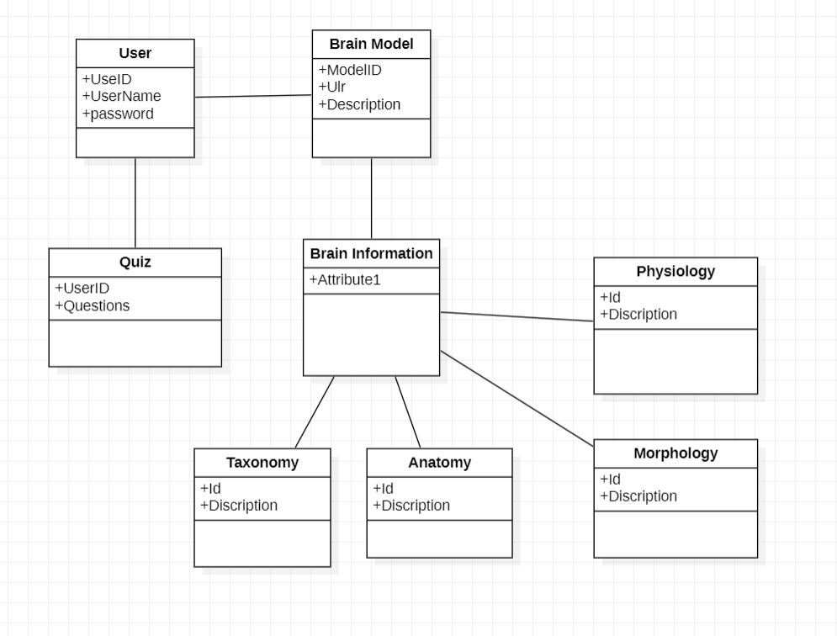
Class Diagram

Slide 12
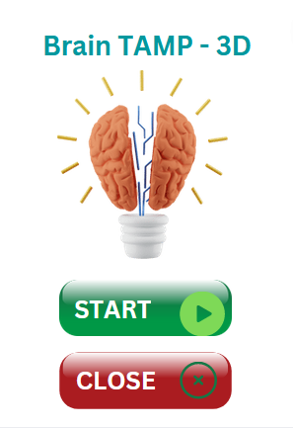
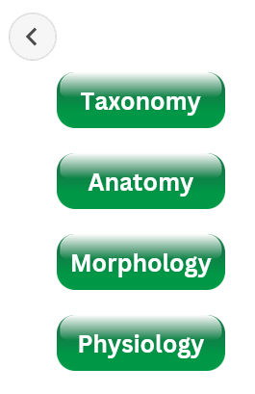
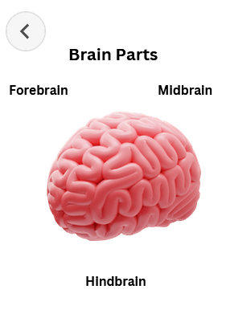
Interface Design

Slide 13
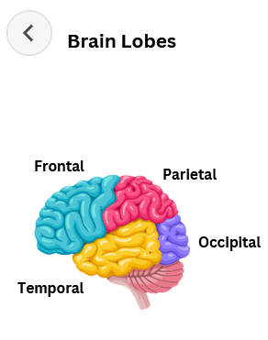
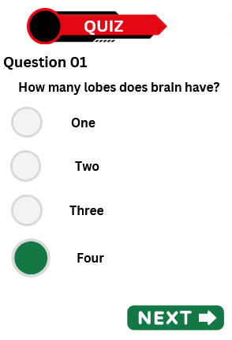
Interface Design

Slide 14
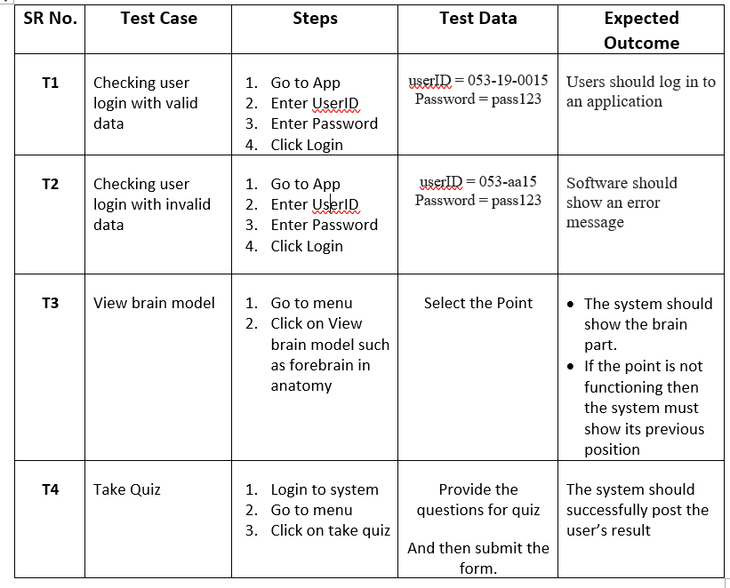
Test Cases

Slide 15
Thank you!

